Slide 1
Homomorphic Encryption
Presented By: Maura Kieft
Notes:
Hi, my name is Maura Kieft. And today I will be presenting to you, Homomorphic encryption.

Slide 2

Origins of Homomorphic Encryption
1978 – shortly after Rivest, Shamir, and Adleman presented RSA encryption
Rivest, Adleman, and Derouzos came up with the concept of privacy homomorphisms
No major progress was made until 10 years later
Craig Gentry – Graduate student at Stanford University, created an algebraically homomorphic encryption system as his graduate thesis
Established first fully homomorphic encryption scheme in 2009
Notes:
In 1978, Shortly after Rivest, Shamir, and Adleman presented RSA encryption…. Rivest, Adleman, and Derouzos came up with the concept of privacy homomorphisms.
There wasn’t any major progress until 10 years later when Craig Genntry, a graduate student at Stanford University, created an algebraically homomorphic encryption system as his graduate thesis. He later established the first fully homomorphic encryption scheme in 2009

Slide 3
What is Homomorphic Encryption(HE)?
In Math – “Homomorphic” describes the transformation of one data set into another while preserving the relationship elements in both sets
Allows computation on encrypted data
Data remains confidential while being processed
Enables useful tasks to be accomplished without data residing in untrusted environments
Helps to protect the integrity of data
No one aside from the private key holder can understand/access its decrypted values
Like other forms of public encryption
Uses a public key to encrypt data
Allows only the individual with matching private key to access unencrypted data
Notes:
What IS homomorphic encryption?
In Math , “Homomorphic” describes the transformation of one data set into another while preserving the relationship elements in both sets.
So, Homomorphic encryption allows computations on encrypted data. The data remains confidential while its being processed and thus enables useful tasks or operations to be accomplished without data residing in untrusted environments. This helps protect the integrity of data by allowing others to manipulate its encrypted form since no one aside from the private key holder can understand or access its decrypted values.
Homomorphic encryption is like other form of public encryption, in that it uses a public key to encrypt data and only the individual with the matching private key is allowed to access unencrypted data.

Slide 4
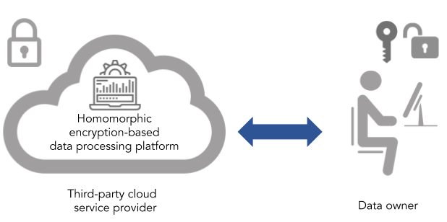
Homomorphic Encryption Real-World Challenges
Has multitude of practical, real-world applications
From electronic voting systems to enabling private queries in search engines to analyzing medical data
Some applications for homomorphic encryption:
Securing data stored in the Cloud
Enabling data analytics in regulated industries
Improving election security and transparency
Notes:
Homomorphic encryption has a multitude of practical, real world applications – everything from electronic voting systems to enabling private queries in search engines to analyzing medial data.
Some applications for homomorphic encryption include:
-Securing data stored in the Cloud….using homomorphic encryption, you can secure the data that you store in the cloud while also having the ability to calculate and search the ciphered information that you can later decrypt without compromising the integrity of the data as a whole. Win-win for business and customers!!
-Enabling data analytics in regulated industries….Homomorphic encryption allows data to be encrypted and outsourced to commercial cloud environments for research and data-sharing purposes, while also protecting user or patient data privacy
-For example, HE allows predictive analytics service providers to safely analyze medical data without putting data privacy at risk
-improving election security and transparency…researches are working on how they can use homomorphic encryption to make elections more transparent and secure.
-can add up various values in an unbiased way using addition operations while also keep their values private
-not only protects data from manipulation, but it could also allow it to be independently verified by authorized third parties

Slide 5
How is HE different from other forms of encryption?
Encryption methods used by traditional cloud storage and computation solutions cannot run on encrypted data
Exposes sensitive data to potentially insecure cloud operators
In homomorphic encryption, encrypted data can be manipulated and analyzed as though it is plaintext without being decrypted
Algebraic system allows you to perform a variety of operations/computations on the encrypted data
Works best with data represented as integers
Use addition and multiplication as operational functions
Enables you (or a third party) to work with and use encrypted data without having access to, or knowing, contents of the encrypted data
Requires few rounds of interactions
Uses arithmetic circuits which focus on addition and multiplication rather than Boolean circuits
Notes:
So, How is homomorphic encryption different from other forms of encryption?
First of all, encryption methods used by traditional cloud storage and computation solutions cannot run on encrypted data since it exposes sensitive data to potentially insecure cloud operators.
Homomorphic encryption allows encrypted data to be manipulated and analyzed as if it were in plaintext without ever being decrypted.
The algebraic system inherent in homormorphic encryption allows you to perform a variety of operations or computations on the encrypted data. This works best when the data is represented as integers as well as addition and multiplication as operational functions
This enables you or a third party to work with and use the encrypted data without ever having access to or knowing the contents of encrypted data. Requires a few rounds of interactions and uses arithmetic circuits which focus on addition and multiplication rather than Boolean circuits used in other methods of secure computation like two-party computation or general multi-party computation

Slide 6
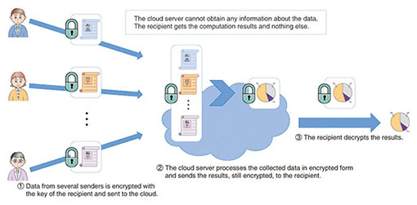
Example: Homomorphic Encryption
Notes:
Users first use an homormorphic encryption scheme to encrypt their own data under the recipient's public key and send it to the cloud server
Data collected on the server is processed in encrypted form using homomorphic evaluation
Result of this processing is the anonymized statistical information (also in encrypted form)
Output is sent to the recipient, who finally decrypts it
Possible uses include validity checks on encrypted ballots, secure auctions and statistical analysis of medical data, etc.

Slide 7
Types of Homomorphic Encryption
Partially Homomorphic Encryption (PHE)
Helps sensitive data remain confidential
Only allow select mathematical functions to be performed on encrypted values
One operation can be performed an unlimited number of times on the ciphertext
Foundation for RSA encryption
Somewhat Homomorphic Encryption (SHE)
Supports limited operations (i.e. either addition OR multiplication) up to a certain complexity
Operations can only be performed a set number of times
Precursor to Fully Homomorphic Encryption
Notes:
There are three main types of homomorphic encryption. The primary difference between them boils down to the types and frequency of mathematical operations that can be performed on their ciphertext.
Partially homomorphic encryption helps sensitive data remain confidential by allowing select mathematic functions to be performed on encrypted values. This means that only one operation can be performed an unlimited number of times on the cipher text. With regard to multiplicative operations, partially homomorphic encryption is the foundation for RSA encryption.
Some examples of partially homomorphic encryption include EIGamal encryption, a multiplication scheme, and Paillier encryption, an addition scheme.
A somewhat homomorphic encryption scheme is one that supports limited operations, either addition OR multiplication, up to a certain complexity, but these operations can only be performed a set number of times. Somewhat homomorphic encryption is the precursor to fully homomorphic encryption.

Slide 8
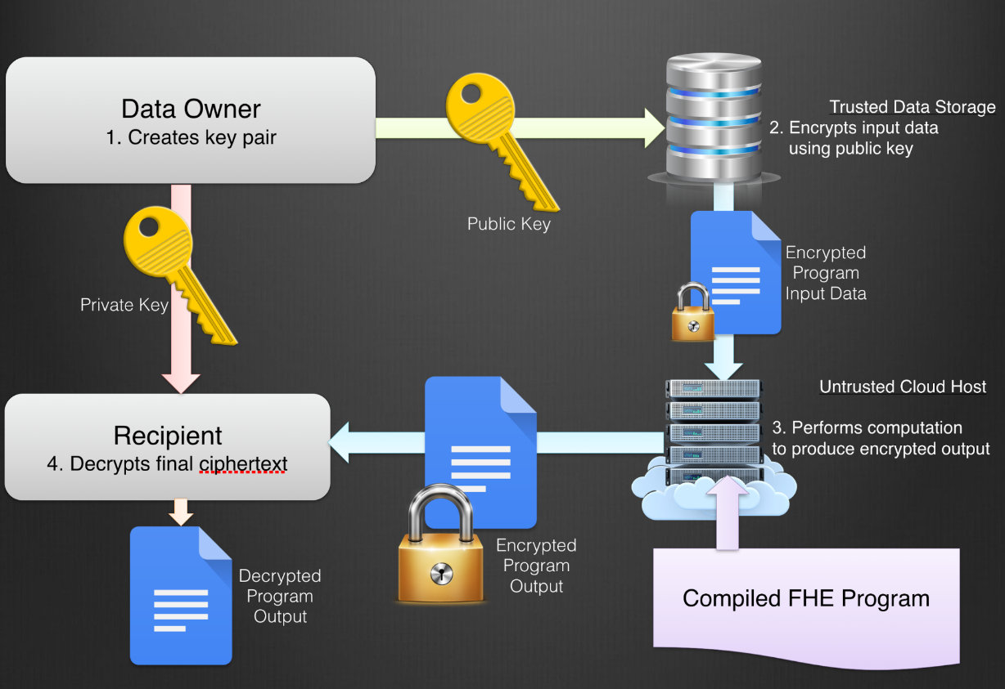
Types of Homomorphic Encryption (cont.)
Fully Homomorphic Encryption (FHE)
Functionality consistent with privacy
Capable of using any efficiently computable functions (addition AND multiplication) any number of times
Makes secure multi-party computation more efficient
Can handle arbitrary computations on your ciphertext
Unlike other forms of HE
Goal: allow anyone to use the encrypted data to perform useful operations without access to the encryption key
Problems?
Each operation in embedded domain introduces “noise”
Has larger computational overhead than plaintext operations
Versatility comes at expense of speed
IBM released its first version of its HElib C++ library in 2014 which reportedly ran 1 trillion times slower than plaintext operations (newer version is 75 times faster than that)
Notes:
Fully homomorphic encryption, although it is still in the development stage, has a lot of potential for making functionality consistent with privacy by helping to keep information secure yet still accessible. It is capable of using ANY efficiently computable functions, such as addition AND multiplication, any number of times and makes secure multi-party computation more efficient. Unlike other forms of homomorphic encryption, it can handle arbitrary computations on your ciphertexts.
The goal behind fully homomorphic encryption is to allowed anyone to use encrypted data to perform useful operations without access to the encryption key.
Figure: First, owner of the sensitive data generates a key pair consisting of a public and a private key.
Second, the owner (or trusted repository)uses the public key to encrypt the data, mapping it to the new domain.
Third, an untrusted computer takes the encrypted data (which they cannot decrypt because does no have the private key) and computes the intended program on it
Fourth, the encrypted result of that computation is decrypted by whoever holds the private key
So why aren’t’ we using fully homomorphic encryption?
-First, each operation embedded in the domain introduces “noise.” As information flows through each gate in our HE circuit, that noise builds up, and at some point we lose the ability to decrypt an output back into a valid plaintext (today we use leveled HE schemes, which can accommodate deep circuits, and bootstrapping, which resets noise without losing privacy)
-has larger computational overhead than plaintext operations because of encryption
-The catch of using gully homomorphic encryption is that its versatility comes at the expense of its speed. It is currently impractically slow. In part because of its larger computation overhead.
-With the goal of making homomorphic encryption widespread, IBM released its first version of its HElib C++ library in 2016 — but it reportedly “ran ‘100 trillion times’ slower than plaintext operations.” Since that time, IBM has continued working to combat this issue and have now come up with a version that is 75 times faster… but even that is still incredibly slow in comparison to working with unencrypted data

Slide 9
“So, basically, anybody can come and they can stick their hands inside the gloves and manipulate what’s inside the locked box. They can’t pull it out, but they can manipulate it; they can process it. They can take raw materials and produce a necklace or something inside the box. And, you know, they finish and [the person with the private key] has to come with the secret key and open it up, and only they can extract the finished product out of there.”
- Craig Gentry glovebox analogy

Slide 10
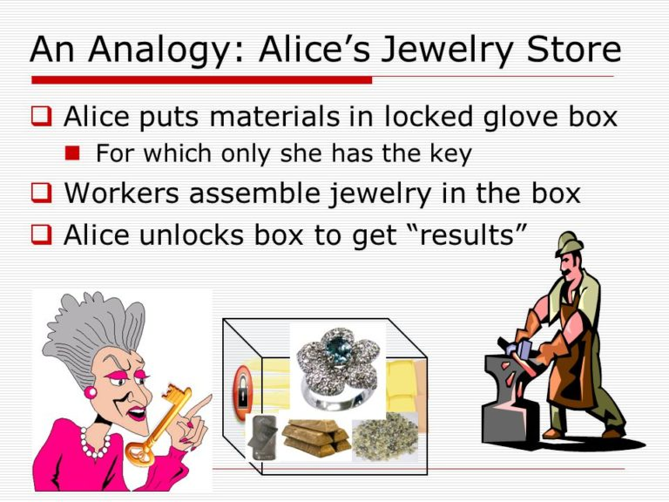
Fully Homomorphic Encryption: Jewelry Store Analogy
Assume that the owner of a jewelry store (Alice) needs her employees to collect valuable materials, yet she is worried about being robbed
She builds glove boxes for which only she has the key and puts the materials inside
Using the gloves, an employee can control and make things inside the box
After the employee is done, Alice can recover the product at her leisure using her key

Slide 11
Definition of a Fully Homomorphic Encryption
Gen(λ)
algorithm of key generation
Input: security parameter
Output: public and secret keys (pk,sk)
Enc(m,pk)
Encryption algorithm
Input: a plaintext m and a public key pk
Output: a ciphertext c
Dec(c, sk)
Decryption algorithm
Input: ciphertext c and a secret key sk
Output: plaintext m
Eval(C, c1,…,cn)
Evaluation algorithm
Input: circuit C and ciphertexts c1,…,cn
Verifies Dec(Eval(C,c1,…,cn),sk) = C(m1,…,mn)
Anyone can evaluate Eval since it doesn’t require the secret key sk
Mathematically, a FHE scheme is a quadruplet of polynomial algorithms (Gen, Enc, Dec, Eval) which verify:
Notes:
(): Is an algorithm of key generation, takes as input a security parameter and outputs public and secret keys
(, ). • (, ): Is an encryption algorithm, takes as input a plaintext and a public key and outputs a ciphertext .
• (, ): Is a decryption algorithm, takes as input a ciphertext and a secret key and outputs a plaintext .
• (, , … , ): Is an evaluation algorithm, takes as input a circuit and ciphertexts , … , and verifies ((, , … , ), ) = (, … , ). Anyone can evaluate , since it does not require the secret key

Slide 12
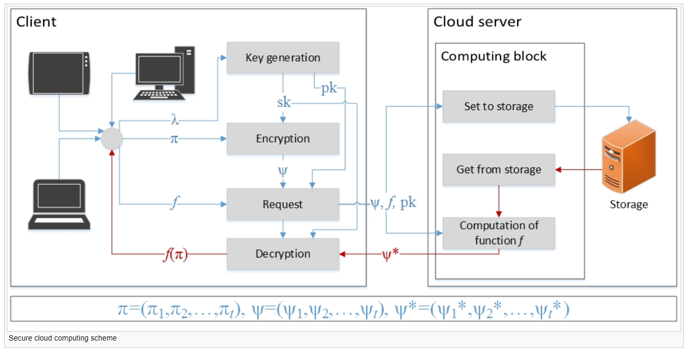
Example: Secure Cloud Computing Scheme
Notes:
Here’s an example of a secure cloud computing organization. In this case, a fully homomorphic encryption is one of the most promising methods in order to reach the necessary level of privacy. The client of the cloud has the ability to store encrypted data on a remote server and later have the server retrieve only files that when they are decrypted satisfy some constraint even though the server cannot decrypt the files on its own.
There are two sides, the client and the server
Client generates a key pair (sk, pk) with specified cryptographic parameter λ
Only client knows a secret key sk, which he uses to encrypt and decrypt data
The key pk is used to form client’s request and is known by the server
Client encrypts data and sends to the server, where the Data is always stored in encrypted form ψ
If client needs some data to satisfy certain conditions, he sends a request to the server which contains the function f, which the server will calculate on the stored encrypted data
Server receives the request, reads the encrypted data and produces the necessary calculations f(ψ) without decrypting the data
The result ψ* is decrypted by the client to obtain the necessary data that satisfies the function f

